Slide 1
Mathematics of Image Formation, Convolution, and Camera Projection
GC University Faisalabad
Course Title: Digital Image Processing Lecture Topic: Mathematics of Image Formation, Convolution, and Camera Projection Instructor: Adnan Majeed Semester: 5th | Credit Hours: 3(2–1)

Slide 2
Lecture Objectives
By the end of this lecture, students will be able to:
Understand the mathematical foundations of how images are formed.
Explain image formation as a physical and geometric process.
Describe and apply convolution for image filtering and feature detection.
Understand camera projection models and their role in converting 3D scenes into 2D images.

Slide 3
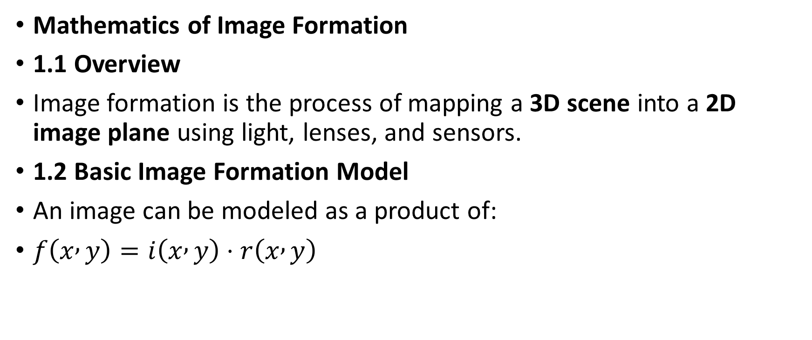
Mathematics of Image Formation
1.1 Overview
Image formation is the process of mapping a 3D scene into a 2D image plane using light, lenses, and sensors.
1.2 Basic Image Formation Model
An image can be modeled as a product of:
$f\left(x , y\right)=i\left(x , y\right)⋅r\left(x , y\right)$

Slide 4
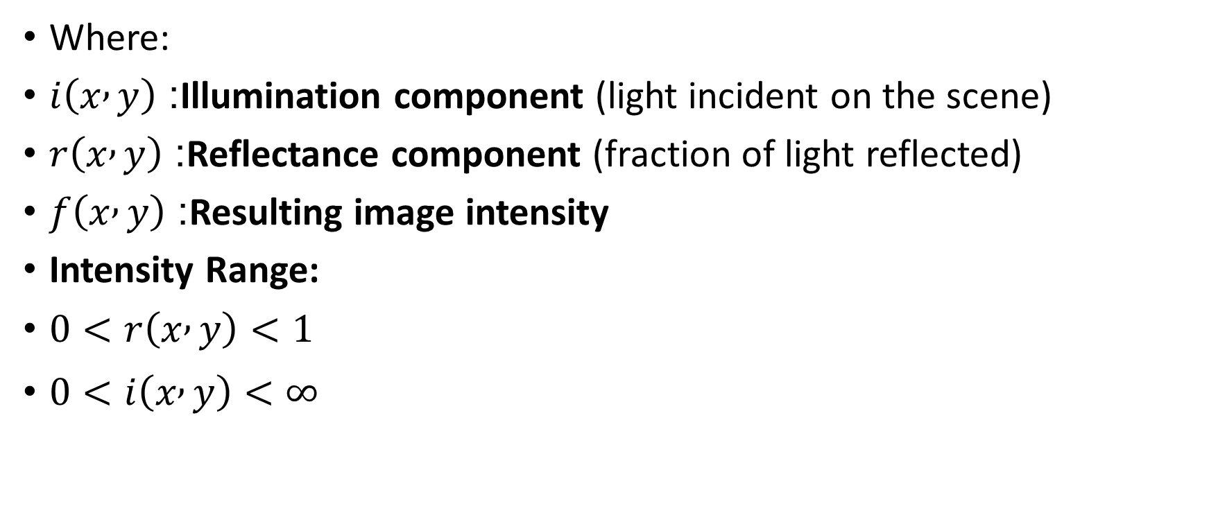
Where:
$i\left(x , y\right)$: Illumination component (light incident on the scene)
$r\left(x , y\right)$: Reflectance component (fraction of light reflected)
$f\left(x , y\right)$: Resulting image intensity
Intensity Range:
$0<r\left(x , y\right)<1$
$0<i\left(x , y\right)<∞$

Slide 5
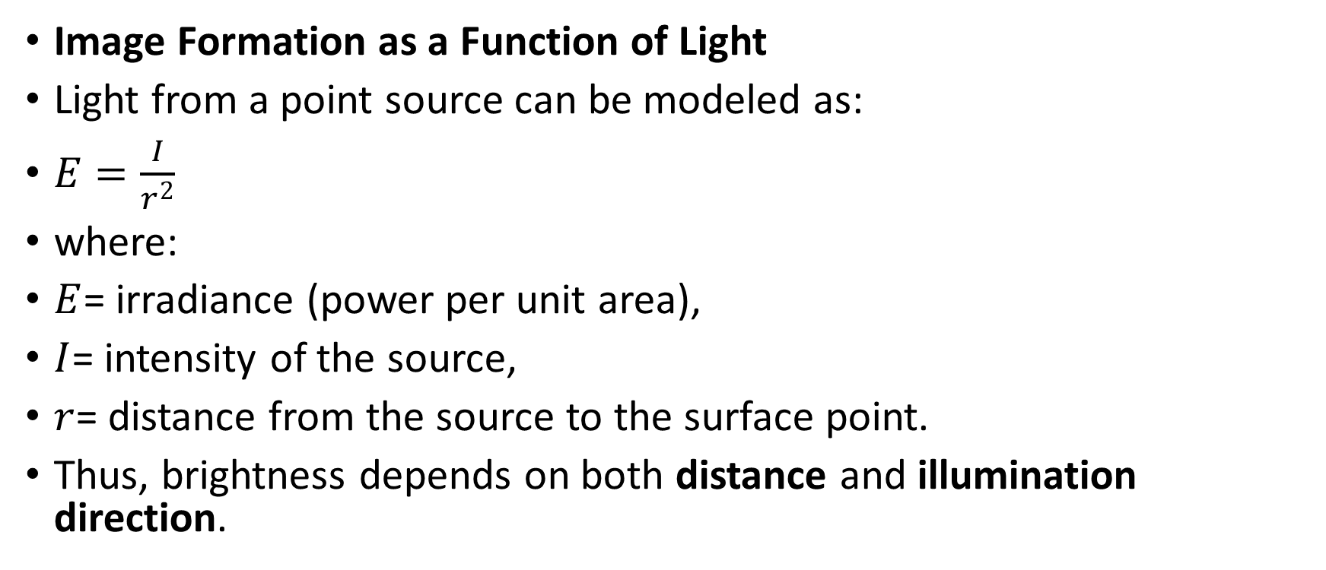
Image Formation as a Function of Light
Light from a point source can be modeled as:
$E=\frac{I}{r^{2}}$
where:
$E$= irradiance (power per unit area),
$I$= intensity of the source,
$r$= distance from the source to the surface point.
Thus, brightness depends on both distance and illumination direction.

Slide 6
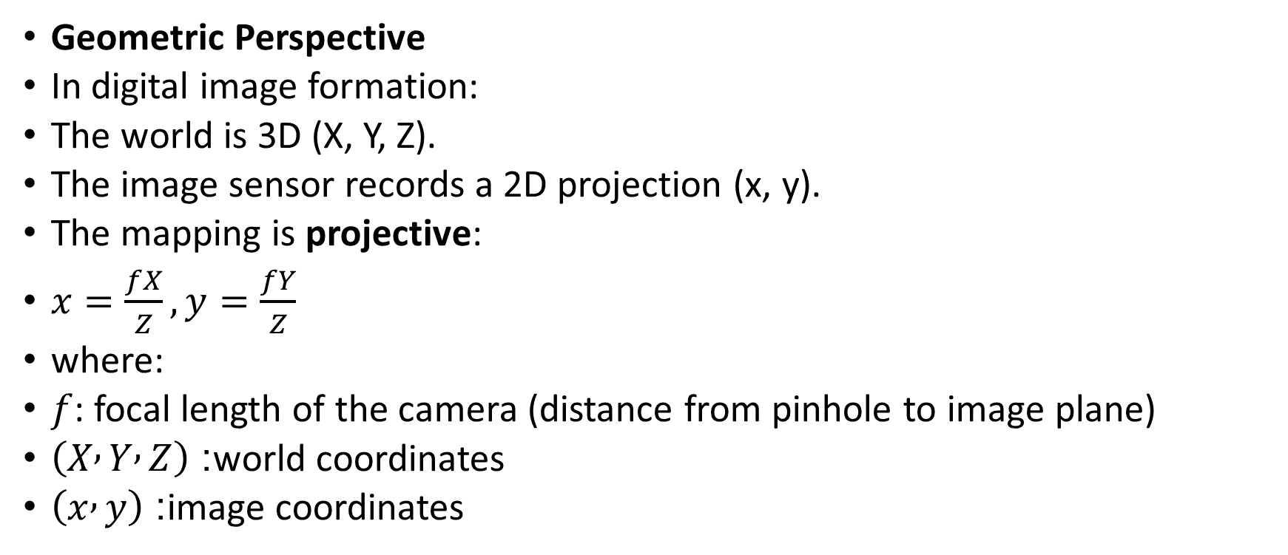
Geometric Perspective
In digital image formation:
The world is 3D (X, Y, Z).
The image sensor records a 2D projection (x, y).
The mapping is projective:
$x=\frac{fX}{Z}, y=\frac{fY}{Z}$
where:
$f$: focal length of the camera (distance from pinhole to image plane)
$\left(X , Y , Z\right)$: world coordinates
$\left(x , y\right)$: image coordinates

Slide 7
Convolution in Image Processing
2.1 Definition
Convolution is a mathematical operation that combines two functions (image and filter/kernel) to produce a third function expressing how the shape of one is modified by the other.
In image processing, convolution is used for:
Image filtering
Edge detection
Blurring/sharpening
Noise reduction

Slide 8
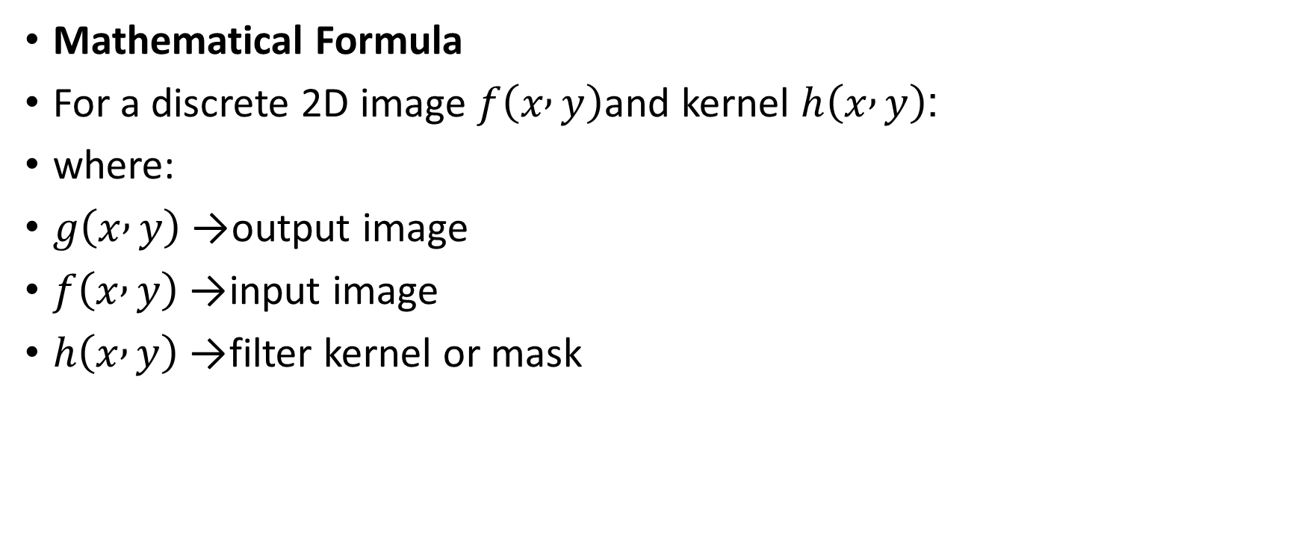
Mathematical Formula
For a discrete 2D image $f\left(x , y\right)$and kernel $h\left(x , y\right)$:
where:
$g\left(x , y\right)$→ output image
$f\left(x , y\right)$→ input image
$h\left(x , y\right)$→ filter kernel or mask

Slide 9
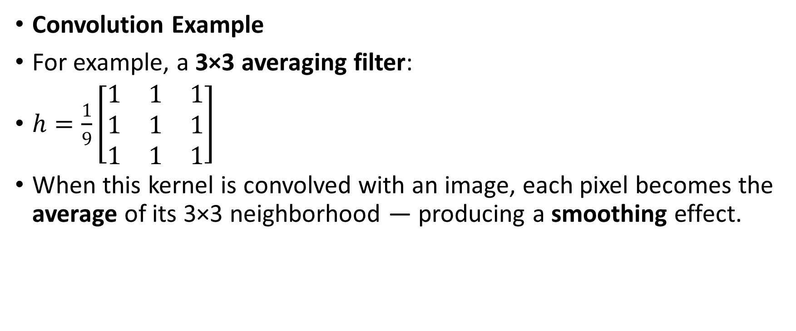
Convolution Example
For example, a 3×3 averaging filter:
$h=\frac{1}{9}\left[\begin{matrix}1 & 1 & 1 \\ 1 & 1 & 1 \\ 1 & 1 & 1\end{matrix}\right]$
When this kernel is convolved with an image, each pixel becomes the average of its 3×3 neighborhood — producing a smoothing effect.

Slide 10
Important Properties of Convolution
Property | Description
Commutative | ( f * h = h * f )
Associative | ( f * (g * h) = (f * g) * h )
Distributive | ( f * (g + h) = f * g + f * h )
Shift Invariance | Convolution does not depend on absolute location

Slide 11
Convolution in Python (Example)
import cv2
import numpy as np
import matplotlib.pyplot as plt
# Read grayscale image
img = cv2.imread('image.jpg', 0)
# Define 3x3 blur kernel
kernel = np.ones((3,3), np.float32) / 9
# Apply convolution
output = cv2.filter2D(img, -1, kernel)
plt.subplot(121), plt.imshow(img, cmap='gray'), plt.title('Original')
plt.subplot(122), plt.imshow(output, cmap='gray'), plt.title('Convolved (Blurred)')
plt.show()

Slide 12
Camera Projection Models
3.1 Overview
The camera projection model describes how 3D points in the real world are projected onto a 2D image plane. It is a cornerstone of computer vision, 3D reconstruction, and augmented reality.

Slide 13
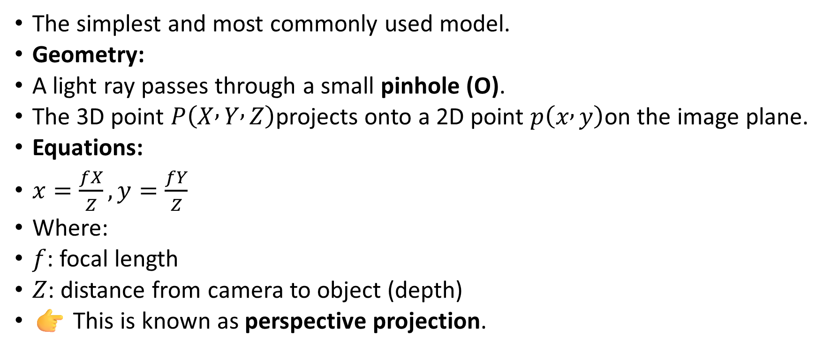
Pinhole Camera Model
The simplest and most commonly used model.
Geometry:
A light ray passes through a small pinhole (O).
The 3D point $P\left(X , Y , Z\right)$projects onto a 2D point $p\left(x , y\right)$on the image plane.
Equations:
$x=\frac{fX}{Z}, y=\frac{fY}{Z}$
Where:
$f$: focal length
$Z$: distance from camera to object (depth)
👉 This is known as perspective projection.

Slide 14

Perspective Projection Matrix
In homogeneous coordinates:
$\left[\begin{matrix}x \\ y \\ 1\end{matrix}\right]=\frac{1}{Z}\left[\begin{matrix}f & 0 & 0 & 0 \\ 0 & f & 0 & 0 \\ 0 & 0 & 1 & 0\end{matrix}\right]\left[\begin{matrix}X \\ Y \\ Z \\ 1\end{matrix}\right]$

Slide 15
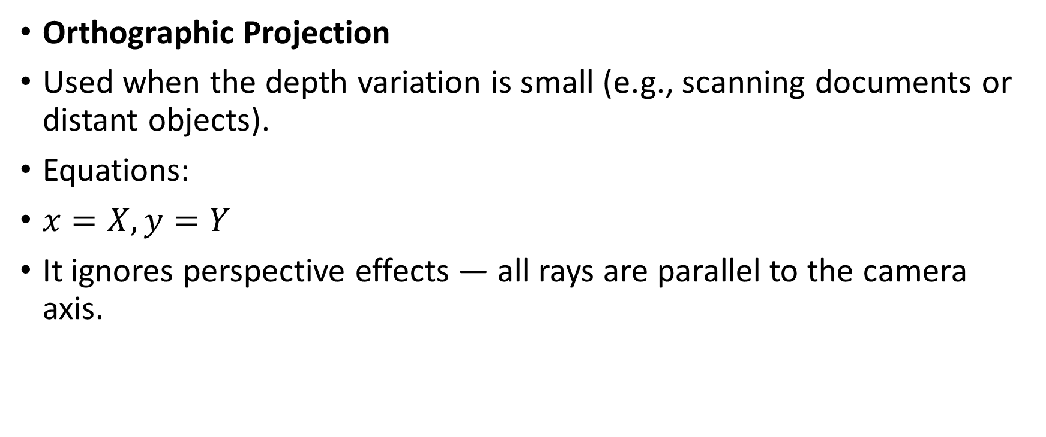
Orthographic Projection
Used when the depth variation is small (e.g., scanning documents or distant objects).
Equations:
$x=X, y=Y$
It ignores perspective effects — all rays are parallel to the camera axis.

Slide 16
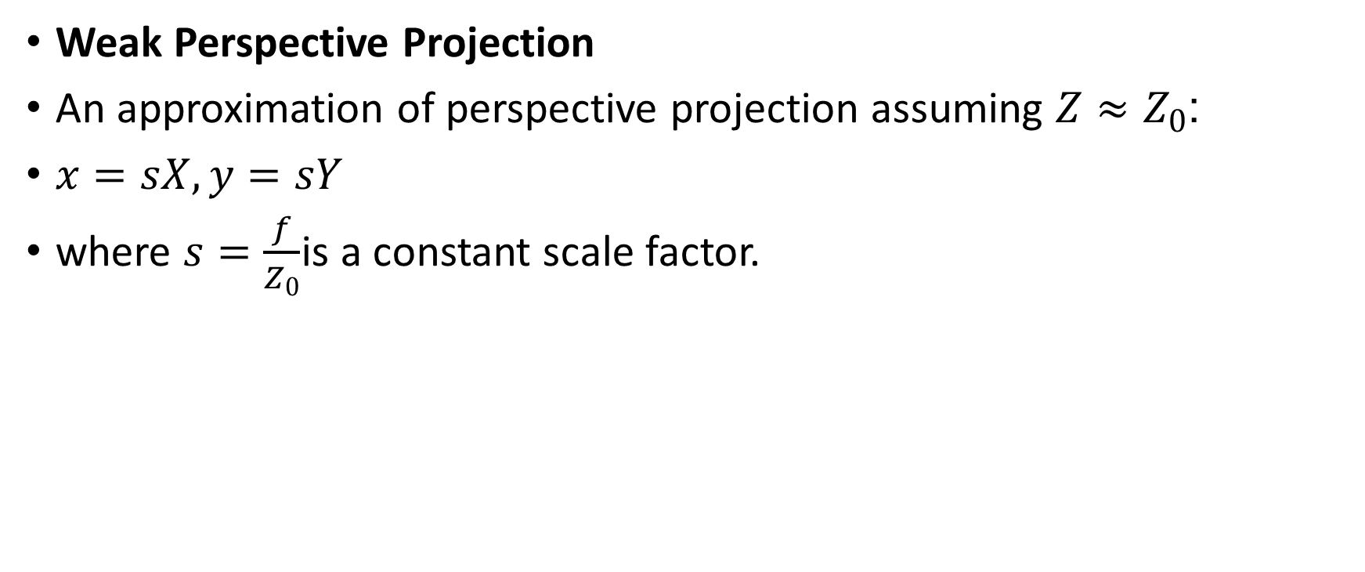
Weak Perspective Projection
An approximation of perspective projection assuming $Z≈Z_{0}$:
$x=sX, y=sY$
where $s=\frac{f}{Z_{0}}$is a constant scale factor.

Slide 17
Comparison Table
Type | Formula | Used For | Perspective Effect
Orthographic | ( x=X, y=Y ) | 2D scanning | None
Perspective | ( x=\frac{fX}{Z}, y=\frac{fY}{Z} ) | 3D scenes | High
Weak Perspective | ( x=sX, y=sY ) | Small objects | Moderate

Slide 18
Camera Coordinate Systems
World Coordinates (X, Y, Z) – Real-world points
Camera Coordinates (Xc, Yc, Zc) – After translation & rotation
Image Coordinates (x, y) – Projection on the sensor plane
Pixel Coordinates (u, v) – Scaled using pixel dimensions

Slide 19

Transformation chain:
$\left(X , Y , Z\right)\underset{→}{Extrinsic}\left(X_{c} , Y_{c} , Z_{c}\right)\underset{→}{Projection}\left(x , y\right)\underset{→}{Intrinsic}\left(u , v\right)$

Slide 20
Summary
Concept | Description
Image Formation | Describes how light, reflection, and geometry produce an image.
Convolution | Mathematical operation combining image and kernel for filtering.
Camera Projection | Describes mapping of 3D world onto 2D image plane.
Pinhole Model | Simplest physical model of image capture using perspective projection.
Orthographic Model | Simplified projection ignoring depth effects.

Slide 21
Review Questions
Explain the illumination and reflectance model in image formation.
Derive the pinhole camera projection equations.
Define convolution and explain its role in image processing.
Differentiate between orthographic and perspective projections.
Write the 2D discrete convolution formula and explain each term.
How does focal length affect image projection?

Slide 22
Recommended Readings
Rafael C. Gonzalez & Richard E. Woods, Digital Image Processing, 4th Edition, Pearson.
Anil K. Jain, Fundamentals of Digital Image Processing, Prentice-Hall.
Szeliski, R., Computer Vision: Algorithms and Applications, Springer.
Gonzalez & Woods, DIP Laboratory Manual – GCUF Computer Science Department.

